Slide 1
CEIS150 Module 4
Inheritance
Summary Report

Slide 2
Rubric
Activity | Requirement(s) | Points
Inherited classes | Screen shot of classes | 15
Unit Tests | Screen Shot of unit tests working | 15
Main program | Screenshot of classes in main | 10

Slide 3
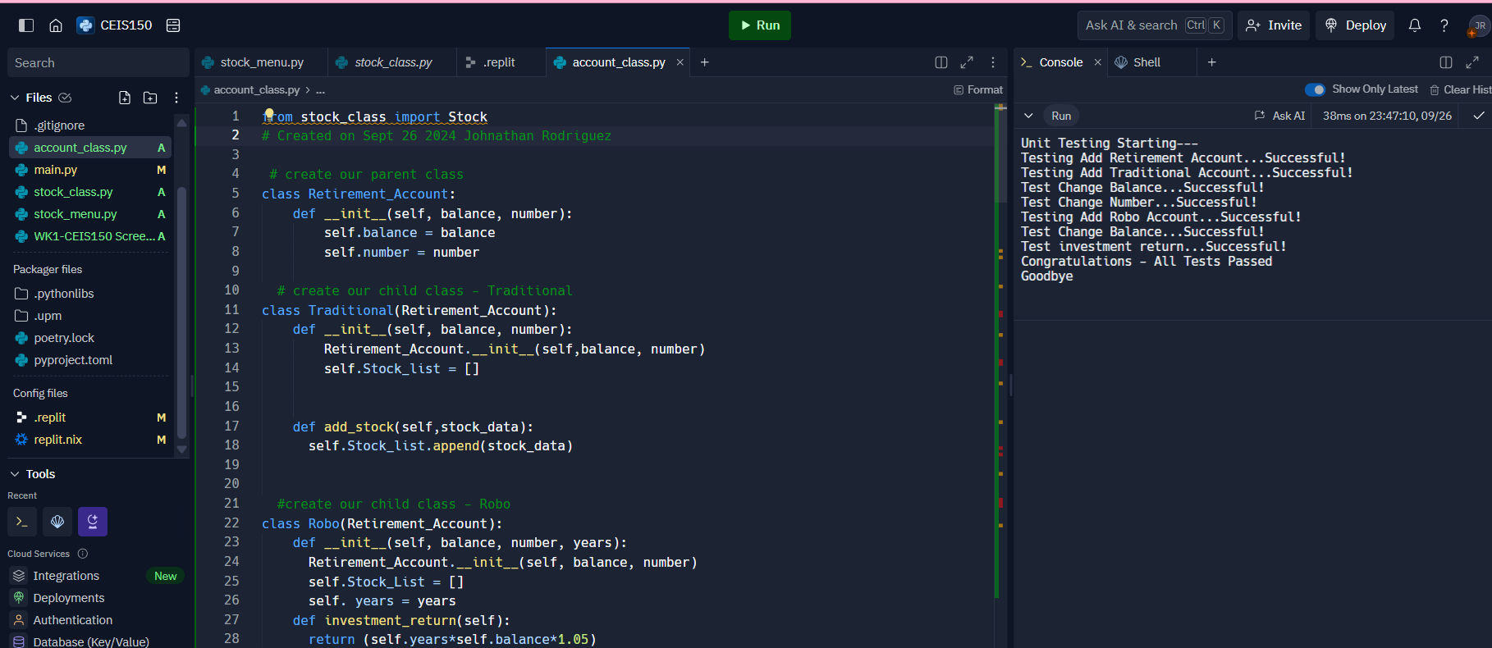
Inherited classes
Paste a screen shot of your classes

Slide 4
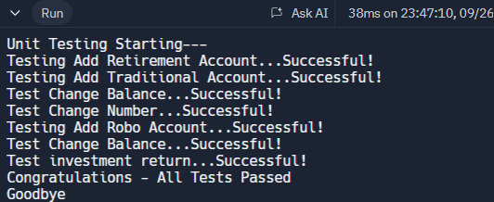
Unit Tests
Paste a screen shot of your unit tests successfully completed

Slide 5
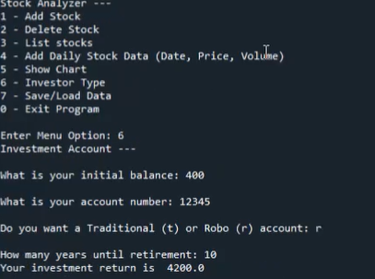
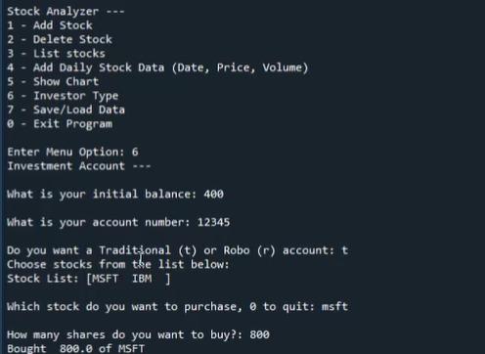
Stock menu program
Paste a screen shot of your classes in the main program

